Slide 1
Insurance Dispute Resolution using Naive Bayes Classifier
PRESENTED BY:
A SAI KALYAN (111516205006)
P VENKATESH (111516205041)
V JAYA ROHITH (111516205058)
FINAL YEAR IT
GUIDED BY:
Dr.D.PRAVEENA
ASSISTANT PROFESSOR
DEPARTMENT OF IT

Slide 2

DOMAIN EXPOSED
NAIVE BAYES ALGORITHM
SVM ALGORITHM

Slide 3
ABSTRACT
Portal for gathering of on spot information during road accidents.
Information comprises of photos ,evidences, reason and FIR.
Data are feeded into a central database by police and doctors.
Responsibility for collecting the data could be given either to police, transport authority, ambulance or even ordinary citizens.
Provision to submit or exchange insurance numbers and details in order to settle the dispute if any arising out of accident.

Slide 4
EXISTING SYSTEM
The system is prone to increased false positives.
There is no filter in place to verify if an accident detected.
DISADVANTAGES:
Difficulties in retrieving the report back for analyzing purpose as this can be a time consuming
The accident reporting form must be completed by handy and often leads to delays in report submission.
These problems disable a quick response from safety and health officer when accident happens and interferes with accident analysis.

Slide 5
PROPOSED SYSTEM
All the information about accident can be directly report to the emergency system.
Maintain a system where we can gather all the information about the spot information during road accidents.
The information which include photos, eyewitnesses, injuries and fatalities, reason, speed, road condition,etc.

Slide 6
CONT...
The centralized server or database is maintained to store the information.
Gathering the information could be offered either to police, transport expert, rescue vehicle or even public.
Provision to submit or exchange insurance numbers and details in order to settle the dispute if any arising out of accident.

Slide 7
ADVANTAGES
The benefits include fewer delays, report submission to various departments simultaneously.
Easier means of reporting and can easily be emailed.
Development of the application, it significantly improves the timeliness of accident reporting.
Application consists of important detail, which is sufficient for summary of accident reporting.

Slide 8
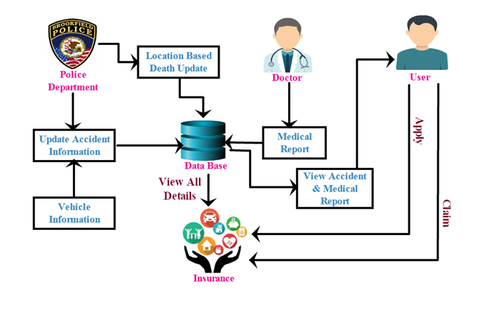
ARCHITECTURE DIAGRAM

Slide 9
MODULES
Accident Data From Concerning Organization
Accident Medical Report
Individual Accident Casualty Report Matching
Insurance Claim For Accident Compensation

Slide 10
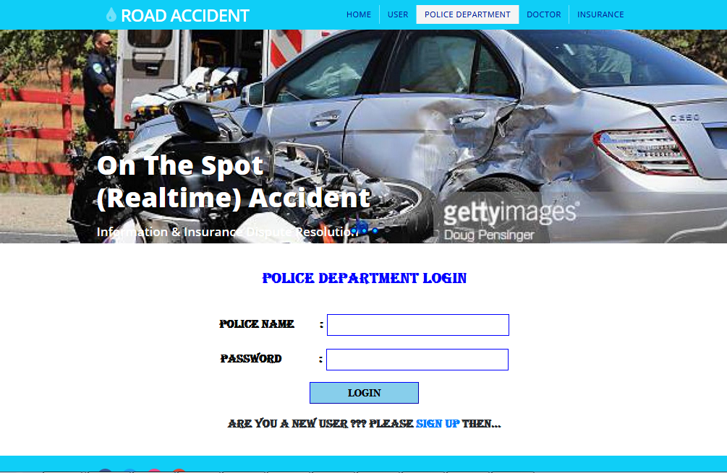
SNAPSHOTS

Slide 11
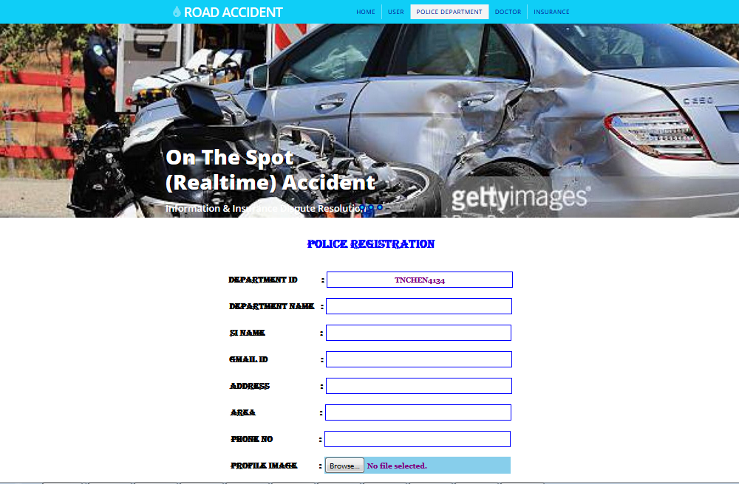

Slide 12
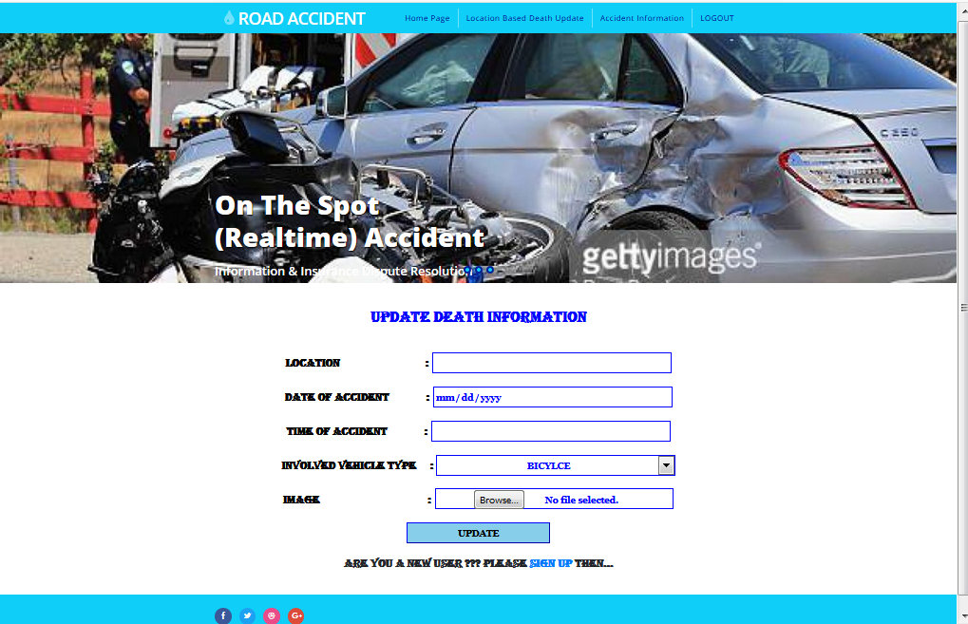

Slide 13
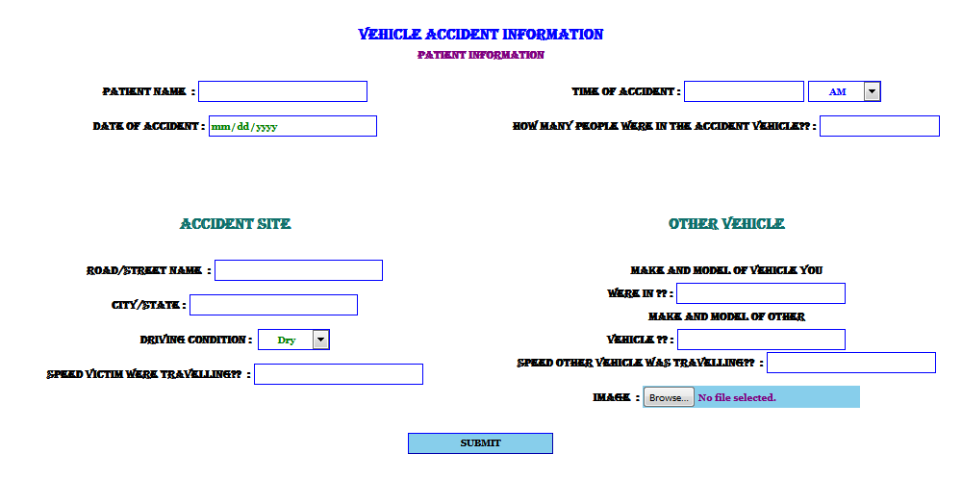

Slide 14
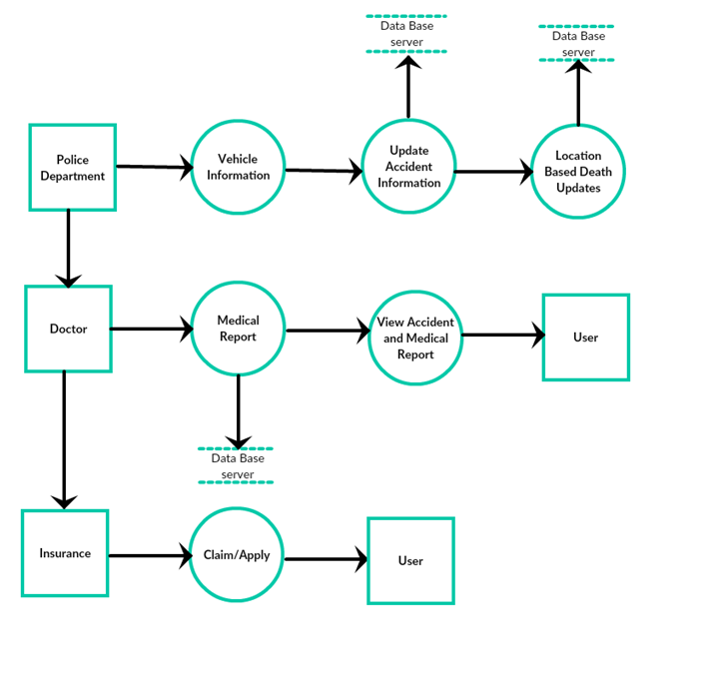
METHODOLOGY

Slide 15
REFERENCES
Road Crash Statistics. (Sep. 2016). [Online]. Available: initiatives/informing-road-users/road-safety-facts/road-crash-statistics
C.-M. Tsai, L.-W. Kang, C.-W. Lin, and W. Lin, “Scene-based movie summarization via role-community networks,” IEEE Trans. Circuits Syst. Video Technol., vol. 23, no. 11, pp. 1927–1940, Nov. 2013.
M. Tavassolipour, M. Karimian, and S. Kasaei, “Event detection and summarization in soccer videos using Bayesian network and Copula,” IEEE Trans. Circuits Syst. Video Technol., vol. 24, no. 2, pp. 291–304, Feb. 2014.
S. Parthasarathy and T. Hasan, “Automatic broadcast news summarization via rank classifiers and crowdsourced annotation,” in Proc. IEEE ICASSP, Apr. 2015, pp. 5256–5260.

